Slide 1

PIQ: Persistent Interactive Queries for Network Security Analytics
ACM SDN-NFV Security ’19, March 27th 2019
Oliver Michel
John Sonchack
Eric Keller
Jonathan M. Smith
Notes:
interactive and retroactive network monitoring queries for security analytics
joint work with John Sonchack and Jonathan Smith from the University of Pennsylvania
and Eric Keller from the University of Colorado Boulder

Slide 2

Network Monitoring is important
Security issues
Performance issues
Equipment failure
Misconfiguration
Persistent Interactive Queries for Network Security Analytics | Oliver Michel
Notes:
continuously monitoring the network is an important task
detecting security issues — attacks
debug performance issues: TCP incast, high queueing latency
detect failures
detect misconfiguration: load imbalance, routing loops, packet drops

Slide 3
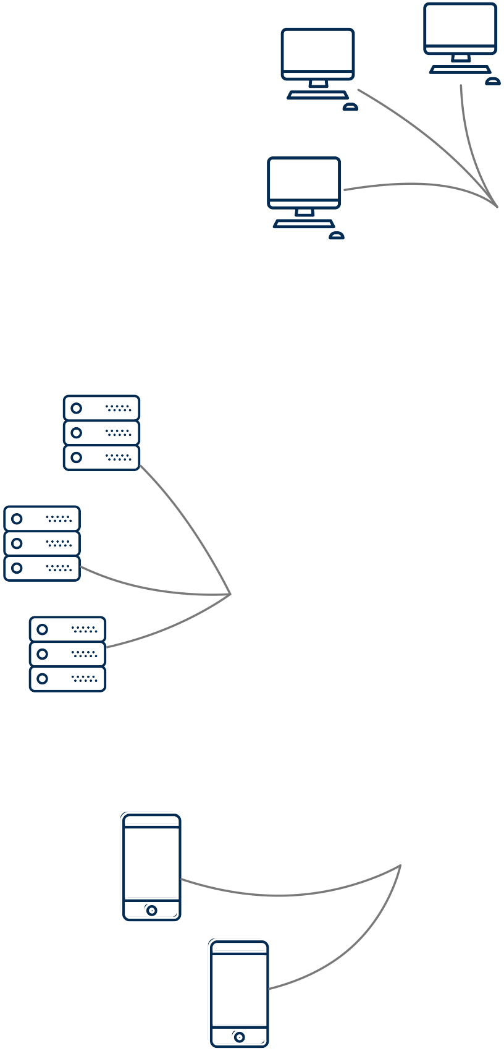
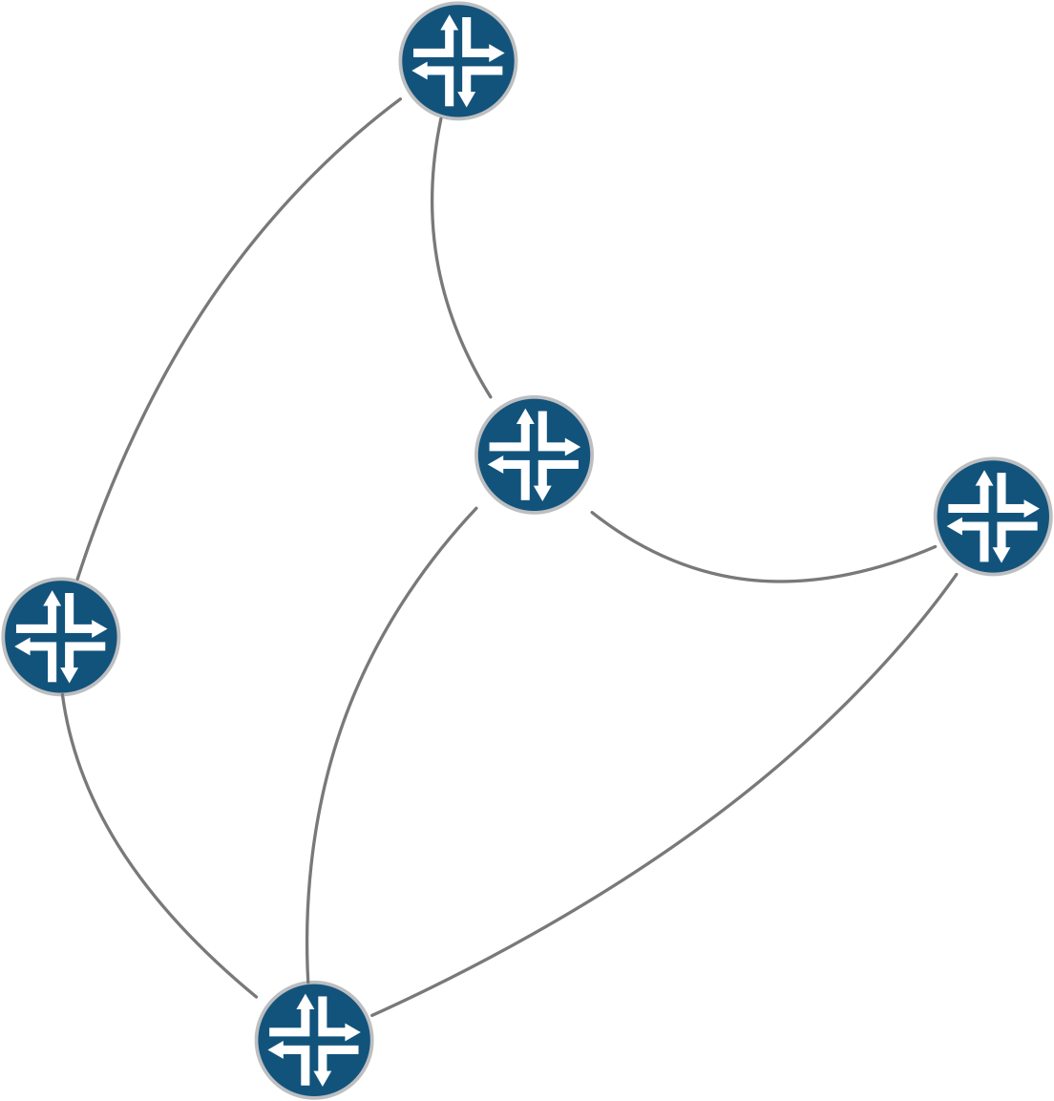
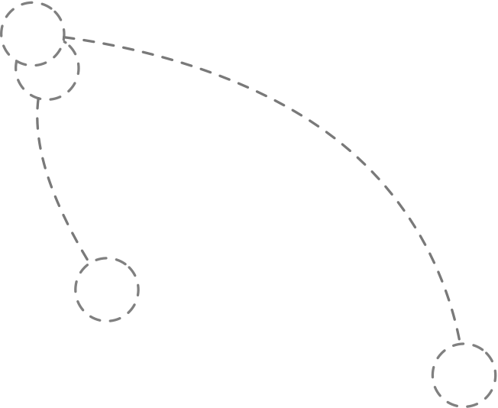
Today’s networks are larger and more complex than ever before
Persistent Interactive Queries for Network Security Analytics | Oliver Michel
Notes:
especially true today
handling variety of services
complex management abstractions, e.g., network virtualization

Slide 4
Today’s networks are larger and more complex than ever before
[Cisco Visual Networking Index 2017]
Persistent Interactive Queries for Network Security Analytics | Oliver Michel
Notes:
on top of that: network traffic rapidly growing
Cisco predicts IP traffic to grow 20% each year

Slide 5
Network Threats grow rapidly
[McAfee Labs Thread Report Dec. 2017]
Persistent Interactive Queries for Network Security Analytics | Oliver Michel
Notes:
at same time: more threats
e.g., # of collected ransomware samples by McAfee doubled since 2015

Slide 6
Passive Monitoring
Telemetry
Analytics
[UnivMon, SIGCOMM ’16]
[Marple, SIGCOMM ’17]
[*Flow, ATC ’18]
[NetQRE, SIGCOMM ’17]
[Jetstream, HotCloud '18]
[Sonata, SIGCOMM ’18]
Persistent Interactive Queries for Network Security Analytics | Oliver Michel
Notes:
introduction of new programmable switches, seen a lot of work focusing on network monitoring
passive monitoring/record-based: export records of actual traffic and then compute statistics
as opposed to polling SNMP
architecture generally divided into two planes
telemetry plane: implemented through programmable switches
extract packet level information, generate records for analysis
analytics plane: often using stream processing
analytics in software
examples

Slide 7
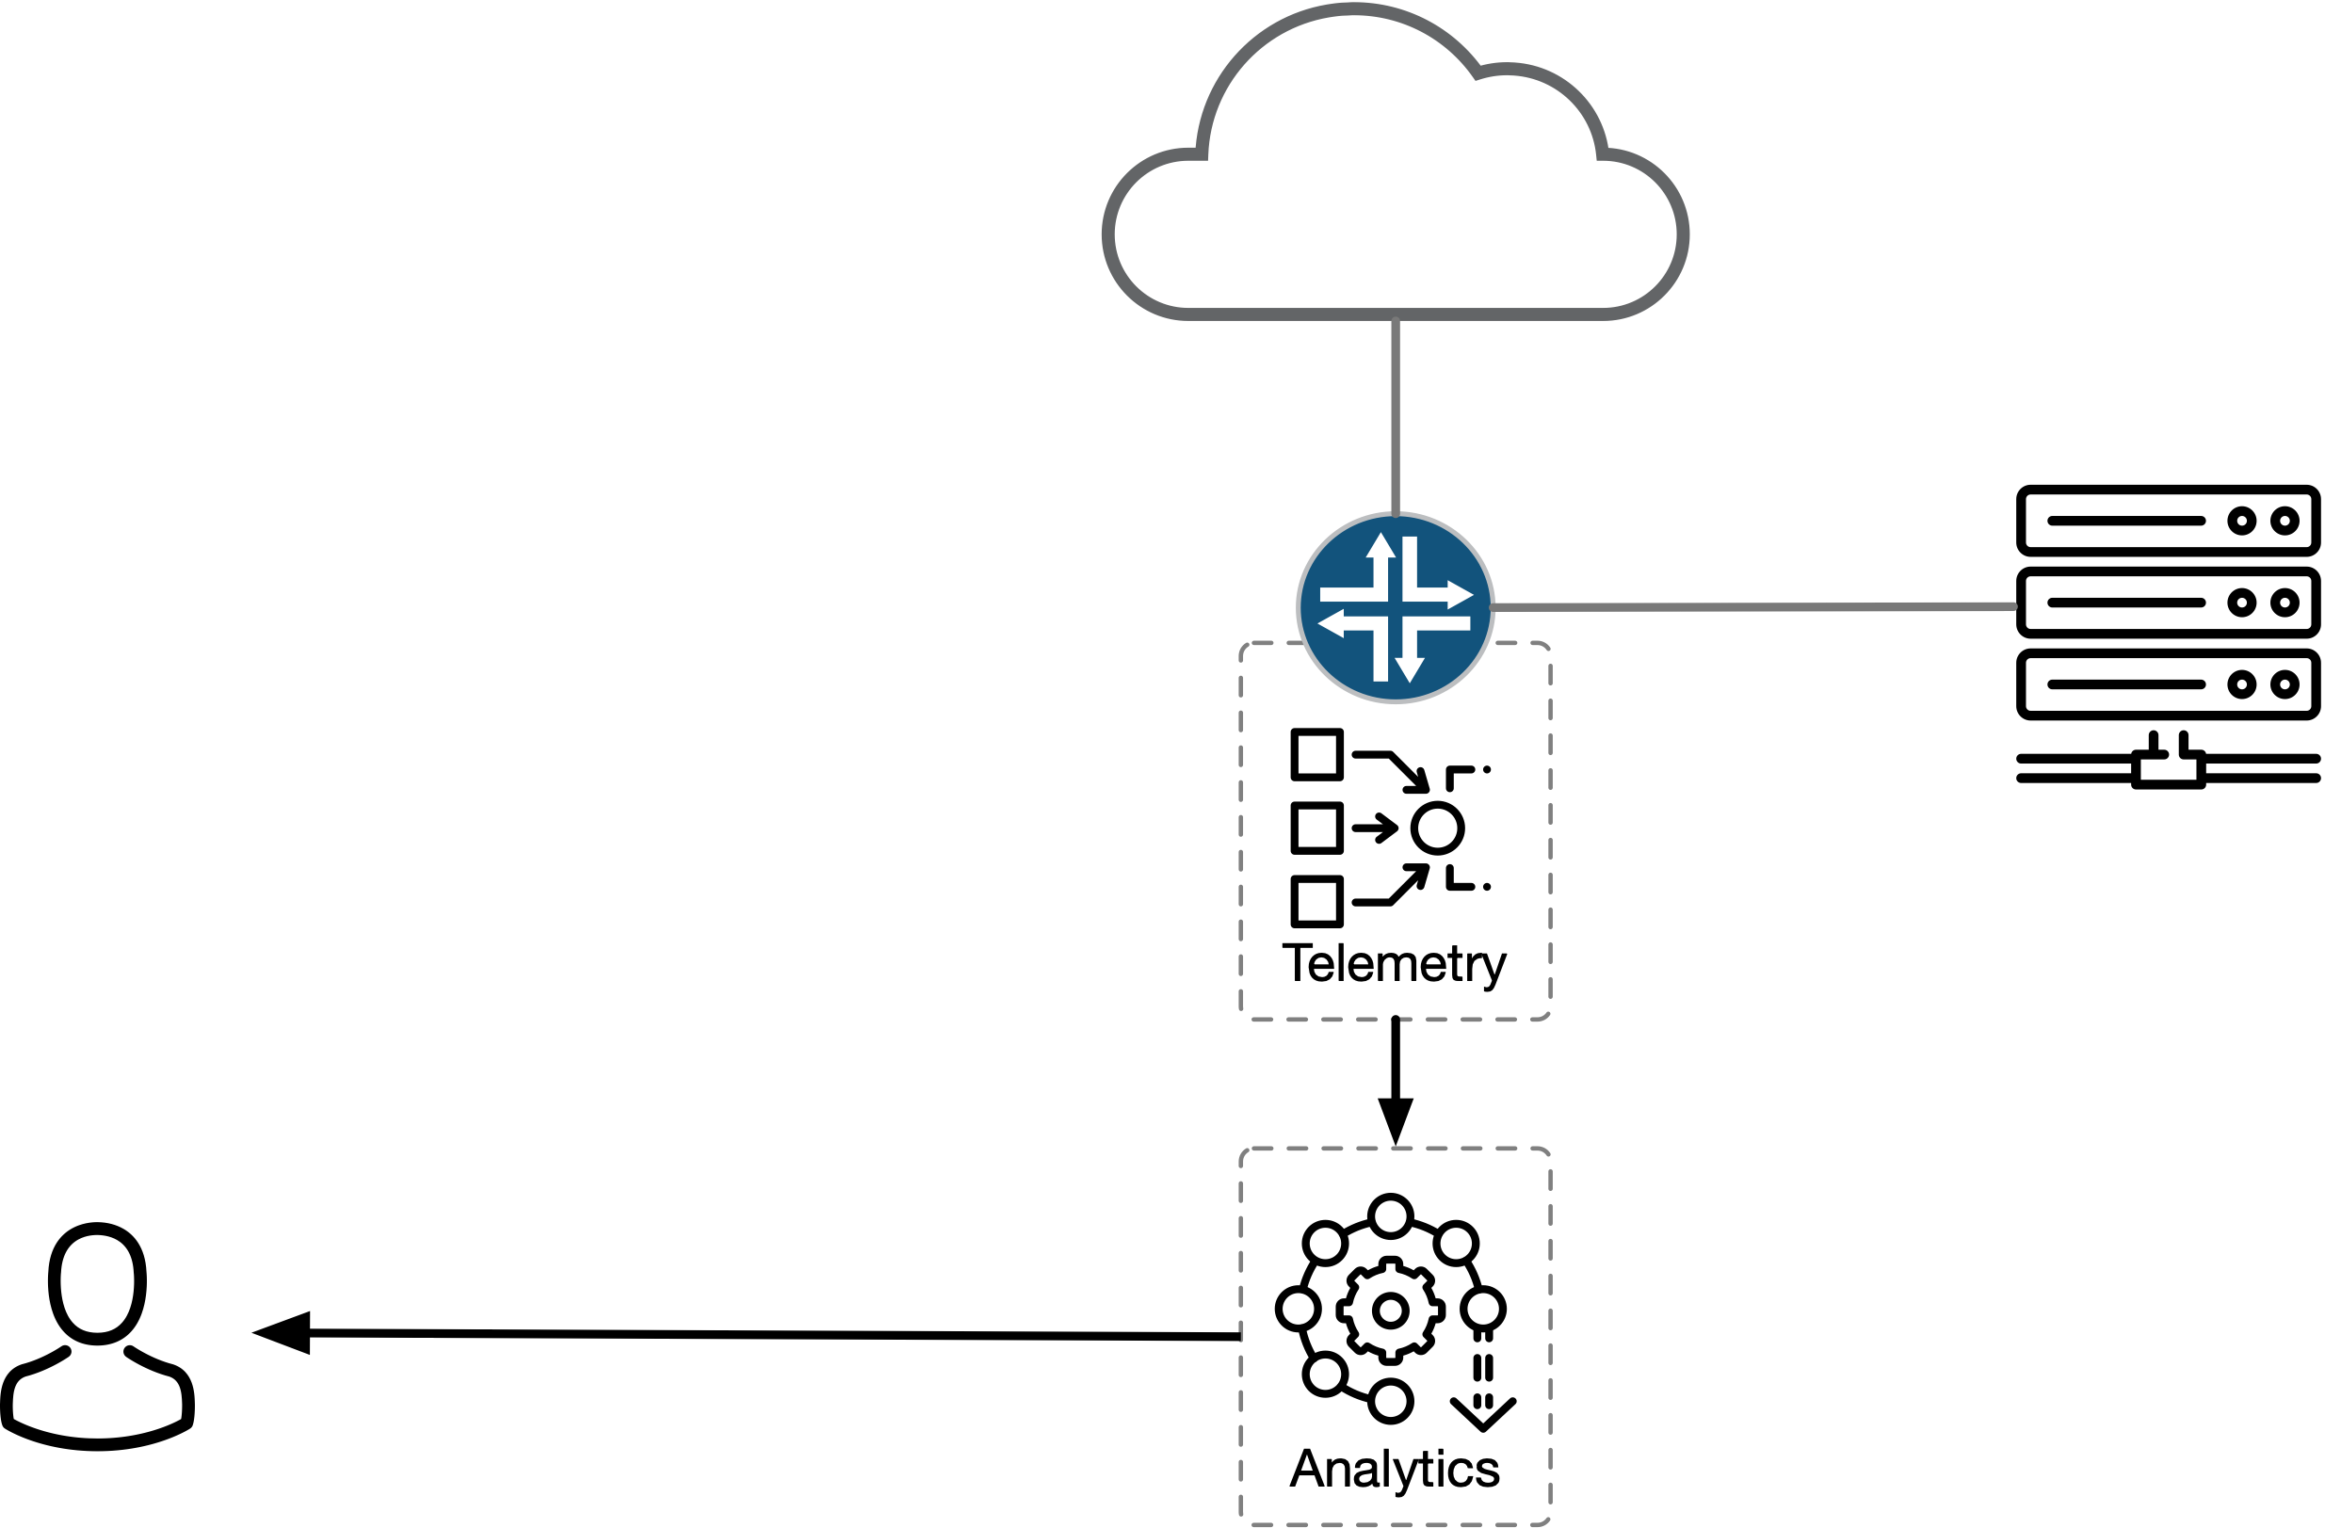
Use in Practice
[ip.src == 10.12.13.14] pkt rate > 10,000/s
[ip.dst == 10.12.13.14] tcp out-of-order > 1000/s
[ip.src == 239.232.230.2] signature consistent with portscan
[ip.src == 123.123/24] traffic from blacklisted subnet
[ip.dst == 234.2.3.99] connections to unknown destination
[switch1 queue 23] queue occupancy > 500 for > 5 min
[ip.src == 10.12.13.14] pkt rate > 10,000/s
[ip.dst == 10.12.13.14] tcp out-of-order > 1000/s
[ip.src == 239.232.230.2] signature consistent with portscan
[ip.src == 123.123/24] traffic from blacklisted subnet
[ip.dst == 234.2.3.99] connections to unknown destination
[ip.src == 10.12.13.14] pkt rate > 10,000/s
[ip.dst == 10.12.13.14] tcp out-of-order > 1000/s
[ip.src == 239.232.230.2] signature consistent with portscan
[ip.src == 123.123/24] traffic from blacklisted subnet
[ip.src == 10.12.13.14] pkt rate > 10,000/s
[ip.dst == 10.12.13.14] tcp out-of-order > 1000/s
[ip.src == 239.232.230.2] signature consistent with portscan
[ip.src == 10.12.13.14] pkt rate > 10,000/s
[ip.dst == 10.12.13.14] tcp out-of-order > 1000/s
[ip.src == 10.12.13.14] pkt rate > 10,000/s
Persistent Interactive Queries for Network Security Analytics | Oliver Michel
Notes:
see how a deployment would look like from operator perspective
PFE-enabled switch at edge of network, equipped with telemetry, exports to analytics plane
analytics plane runs long-running queries to detect a baseline of anomalies, generates alerts
examples: [⇥⇥⇥⇥⇥⇥]
problem: important to know/detect but information is insufficient to debug

Slide 8


Use in Practice
[switch1 queue 23] queue occupancy > 500 for > 5 min
avg. occupancy 627
2018-11-28 15:23:12.023112
incident id: 38df6e44
38df6e44
Persistent Interactive Queries for Network Security Analytics | Oliver Michel
Notes:
at very least: more detailed information
exact condition that triggered alert
precise timestamp
most importantly: some reference to the incident
allow operator or secondary system to look at exact packets that caused the condition
look at problem in detail, perform manual or detailed data analysis

Slide 9
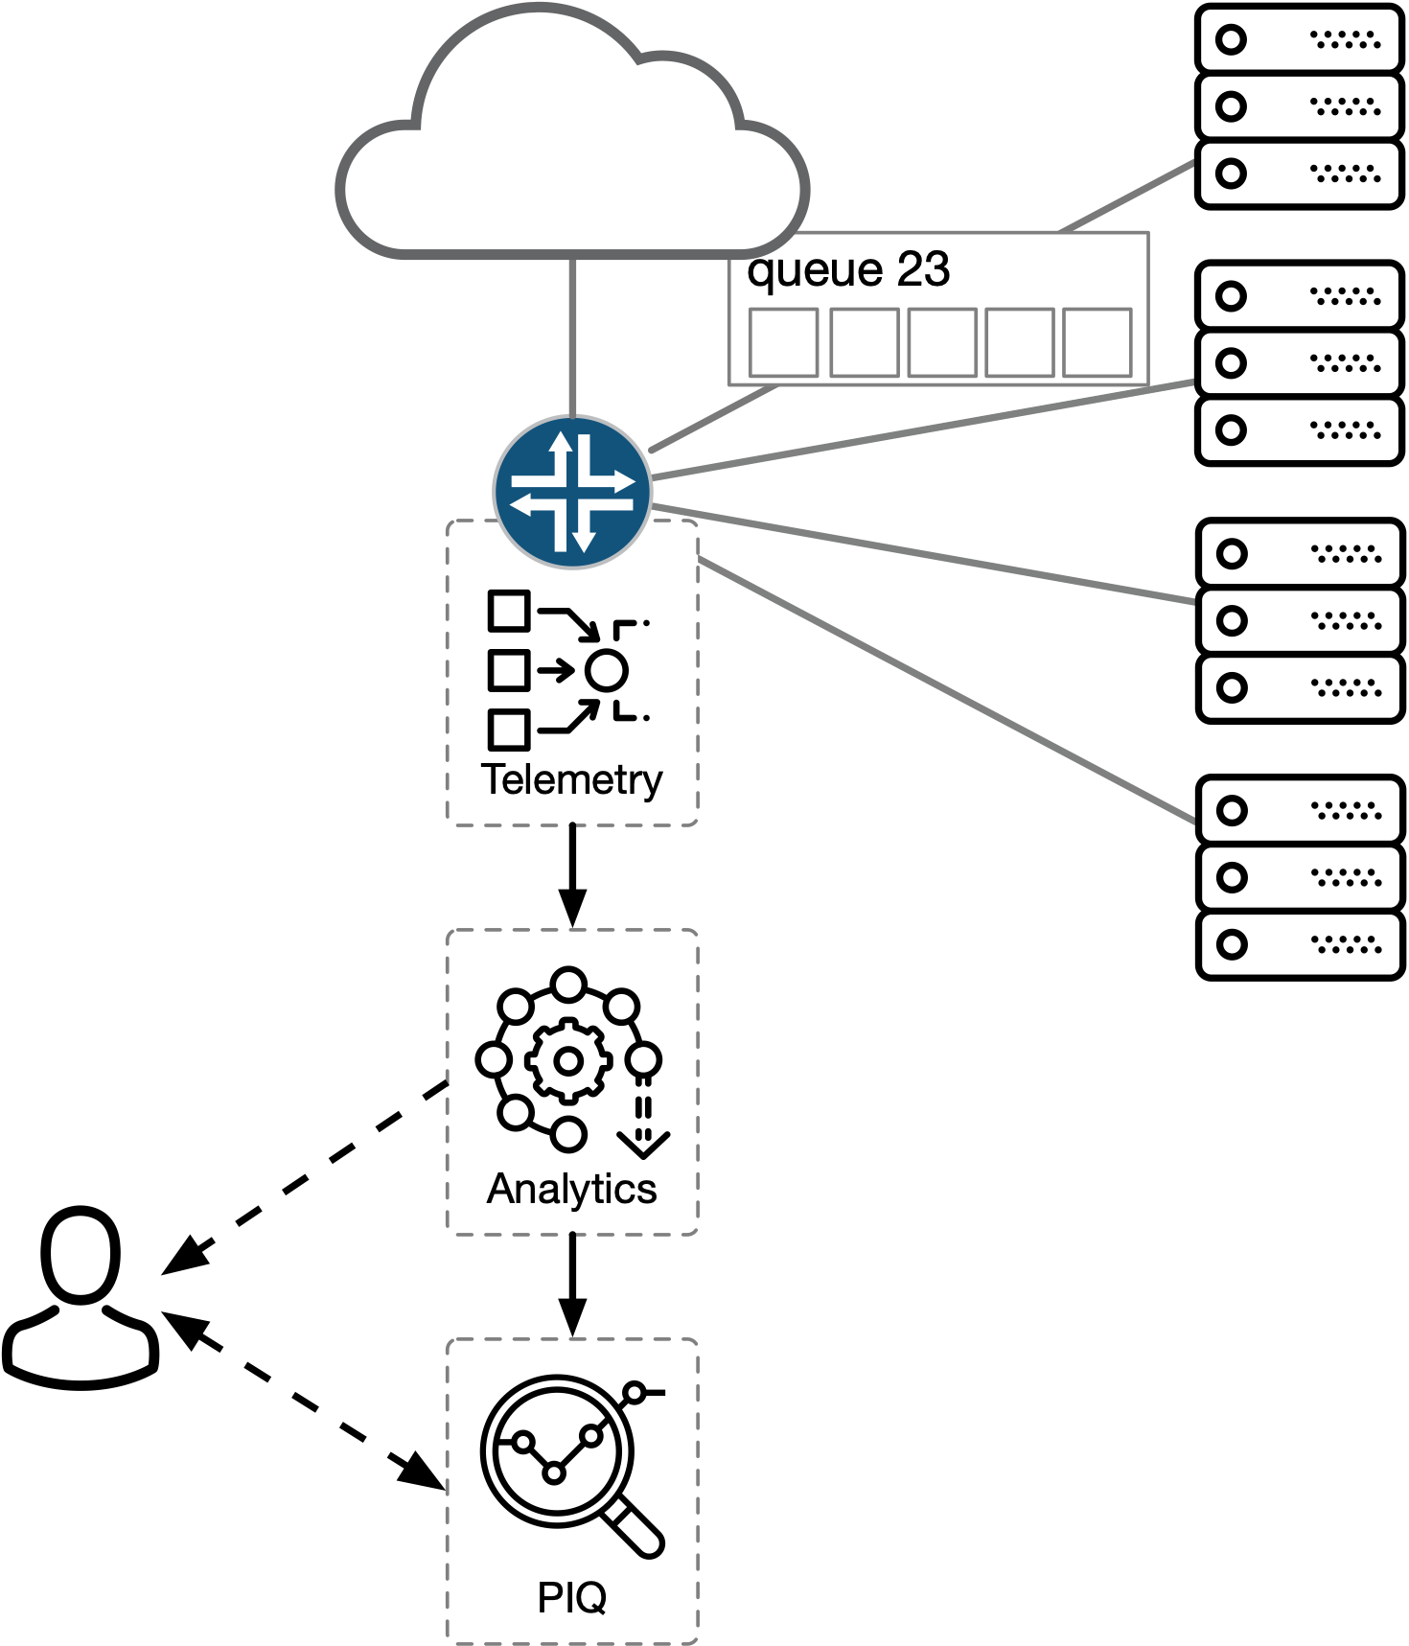
Retrospective Network Queries
Is there a configuration problem or do we ‘just’ receive
more than usual traffic?
“show me sample 38df6e44”
traffic looks normal
“show me information about queue 23”
queue is part of load balancing group
“what other queues are in that load balancing group?”
queues 24, 25, and 26
“show me traffic in queues 24, 25, 26 at 2018-11-28 15:23:12.023112”
only control traffic
Problem with Hashing? Other queues in group disabled?
Persistent Interactive Queries for Network Security Analytics | Oliver Michel
Notes:
introduce retrospective queries: a queue had an unusually high queue occupancy
question: is there ‘just’ a lot of traffic or is there an issue → security or performance
sample id … look at sample, apply different filters, maybe a standard summary script
more information about location of the incident … queue is part of load balancing group
what other queues are in that group? 24, 25, 26
look at traffic in those queues: see only control traffic, maybe generate histogram of packet distribution
conclusion: something is going on … hashing, misconfiguration etc. — with just a warning would not have been able to figure out the exact problem: applies to many phenomena, especially everything that is across flows and at longer time scales, say Slowloris attack

Slide 10

Retrospective Network Queries
Persistent
Interactive Queries
Database
Query Interface
Persistent Interactive Queries for Network Security Analytics | Oliver Michel
Notes:
how to implement a system with this capability
title suggests: two components
persistent: need some way to store data beyond the short aggregation windows of the high throughput analytics system
query interface: interactively look at data, present the data in different forms depending on problem

Slide 11
Retrospective Network Queries
Storing Network Records
Injecting Records into a Database
Querying the Database
Persistent Interactive Queries for Network Security Analytics | Oliver Michel
Notes:
after motivating need: three aspects to highlight
store records
efficiently inject records
query

Slide 12
Grouped Packet Vectors
[Sonchack et.al. *Flow, USENIX ATC 2019]
per-packet header fields
meta data: e.g., queue depth, ingress/egress timestamps
22.4.24.9
118.24.1.7
6
34323
22
1.0239
34
SYN
…
Packet Records
22.4.24.9
118.24.1.7
6
34323
22
1.7865
12
SYN,ACK
…
22.4.24.9
118.24.1.7
6
34323
22
2.3239
45
FIN
…
aggregation keys
1.0239
34
SYN
…
packet features
GPV
22.4.24.9
118.24.1.7
6
34323
22
1.7865
12
SYN,ACK
…
2.3239
45
FIN
…
aggregated features
Flow Records
22.4.24.9
118.24.1.7
6
34323
22
1.0239
1.1000
3
91
Persistent Interactive Queries for Network Security Analytics | Oliver Michel
Notes:
first record format: leverage our previous work
record format that PFE can assemble send to CPU: grouped packet vectors
look at extremes
packet records: duplicated information, not flexible
flow records: generally rely on aggregation but we need per-packet data
middle ground: grouped packet vectors: flow records with per [⇥] packet information

Slide 13
Grouped Packet Vectors
GPVs provide high compression while maintaining information richness
Persistent Interactive Queries for Network Security Analytics | Oliver Michel
Notes:
efficiency: 72GB CAIDA Internet packet trace (headers)
9.4 GB GPV data with μs timestamps, per packet sizes, tcp flags — compression 7.7x
2.3 GB of NetFlow — aggregated values

Slide 14









Database Models
Relational
NoSQL
Time-Series
optimized for time-series data
append-heavy workloads
grouping functionality based on time
timestamps as primary keys for data
relational or NoSQL
Persistent Interactive Queries for Network Security Analytics | Oliver Michel
Notes:
decided need a database: database systems generally come in two flavors
relational: rely on rigid relational model: more traditional enterprise workloads
noSQL: more big data applications, generally better scalability, but less powerful ecosystem and query interface
not an entirely new category but more recent development: time-series optimized databases —slide
network monitoring records are inherently append, organized by time, from that point only read
chose timescale, relational postgres-based time-series database system: reasons why later

Slide 15
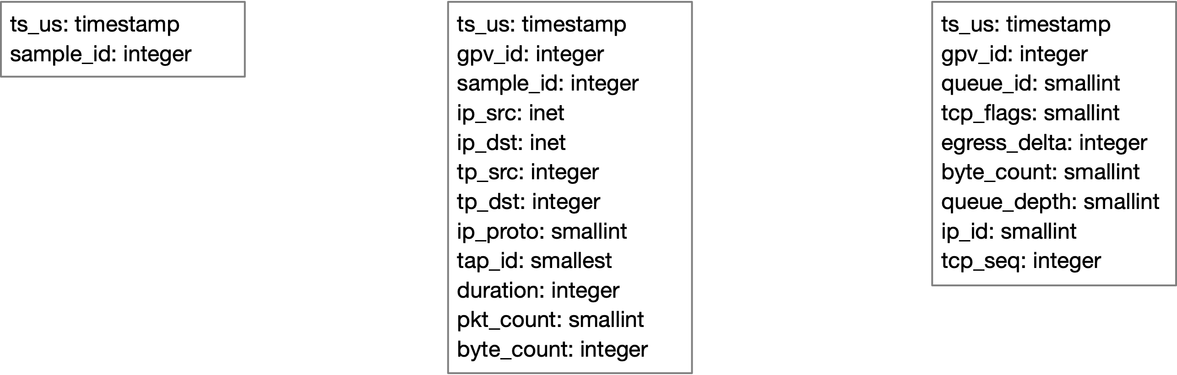
Storing Network Records
Persistent Interactive Queries for Network Security Analytics | Oliver Michel
Notes:
GPV for storage, can be associated with a sample
packet records are separate relation
fields in detail: pkt_count, byte_count in gpv (duplication)
allows to after just delete pkt records, most queries still work, just don’t have per packet data anymore
most queries on gpv relation with join on gpv, requires relational model and SQL
with other time series DBs not easily possible

Slide 16
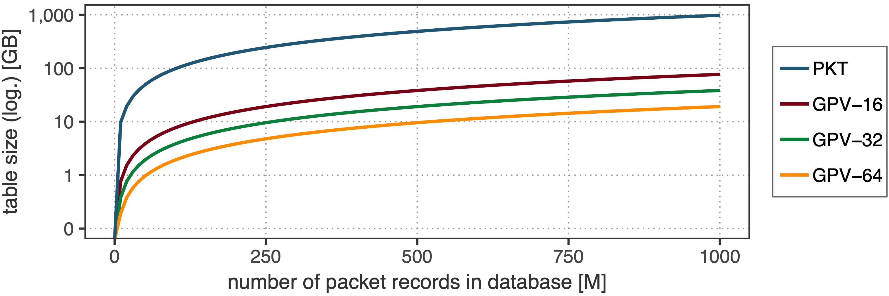
Storing Network Records
Persistent Interactive Queries for Network Security Analytics | Oliver Michel
Notes:
measured the table size in timescale: grows linearly with record count
pkt vs. gpv header record count ratio dependent on cache configuration
between pkt and gpv at least 1 order of magnitude difference
1 billion records 1TB + 20 - 90 GB

Slide 17
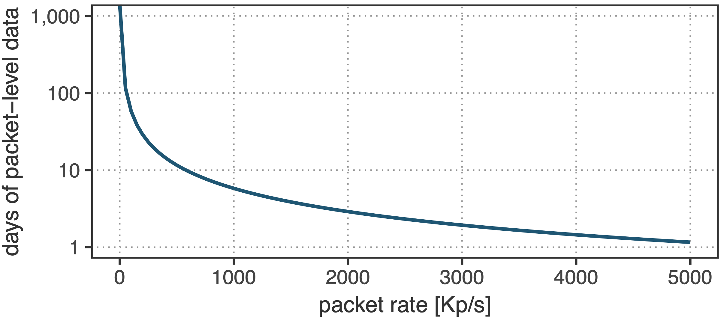
Storing Network Records
Persistent Interactive Queries for Network Security Analytics | Oliver Michel
Notes:
budget of 500B rows (roughly 500TB): caida packet traces had rate of around 330K/s -> 17 days of packet-level retention
various policies for data retention on both packet and flow level are imaginable
30-50K USD for such a storage system, disk array of 4 TB SATA disks

Slide 18


Injecting Network Records
INSERT INTO packets VALUES
(‘2018-11-25 19:02:23.023219’,
‘123.213.123.4’, ‘213.11.23.23’, …)
1 auto buf = new char[h_len + 10000
2 * rec_len + t_len];
3
4 // 10000 times
5 pkt.write_to_pg_buf(buf, offset);
6
7 pg_conn.copy(“pkt”, buf, sizeof(buf));
Persistent Interactive Queries for Network Security Analytics | Oliver Michel
Notes:
next aspect: big challenge: inserting data
two ways
most common/widely known: INSERT: [⇥ ] data needs to be parsed ~15K records/s
COPY (different types) binary: [⇥ ] ~300-360K records (>20x improvement)

Slide 19
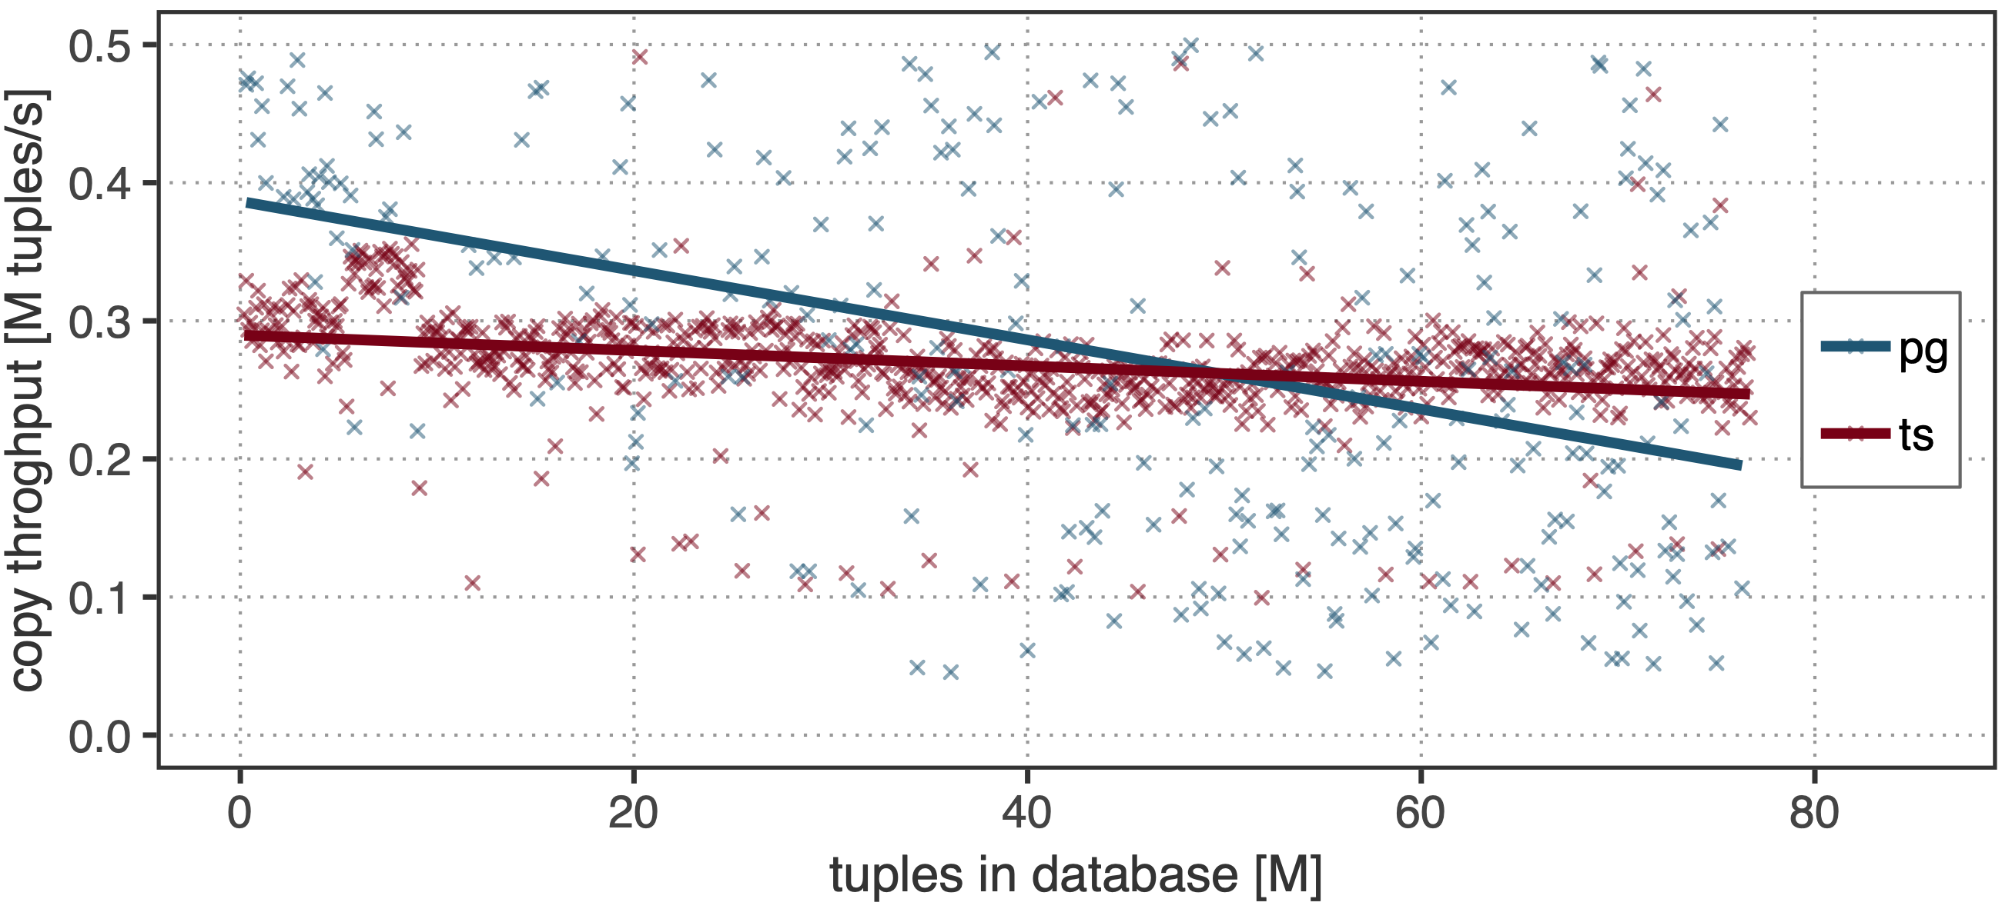
Injecting Network Records
Persistent Interactive Queries for Network Security Analytics | Oliver Michel
Notes:
timescale vs. vanilla postgres insert:
postgres performance declines faster with time
mostly due to complex indices
timescale indices are local to chunks, data ordered by timestamp…details in paper

Slide 20
Querying Network Records
SELECT time_bucket('1 seconds', ts_us) AS interval, SUM(pkt_count), SUM(byte_count)
FROM gpv GROUP BY interval ORDER BY interval ASC
SELECT * FROM (gpv RIGHT JOIN pkt ON gpv.gpv_id = pkt.gpv_id)
WHERE gpv.ip_src << inet '60.70.0.0/16'
Persistent Interactive Queries for Network Security Analytics | Oliver Michel
Notes:
third: query interface
use the power of SQL: aggregation, joins, and time series optimized helper functions
generate a graph with 1s buckets
all packets from that subnet

Slide 21

Querying Network Records
SELECT DISTINCT gpv.ip_src, gpv.ip_dst, gpv.ip_proto, gpv.tp_src, gpv.tp_dst
FROM (gpv RIGHT JOIN pkt ON gpv.gpv_id = pkt.gpv_id)
WHERE pkt.ingress_ts >= '2018-02-19 12:59:11.595’
AND pkt.ingress_ts < '2018-02-19 12:59:11.600'
AND pkt.queue_id = ’23’
SELECT pkt.queue_id, COUNT(pkt.queue_id)
FROM (gpv RIGHT JOIN pkt ON gpv.gpv_id = pkt.gpv_id)
WHERE gpv.ip_dst << inet ’53.231/16'
AND pkt.queue_id IN (23,24,25,26)
GROUP BY pkt.queue_id;
Persistent Interactive Queries for Network Security Analytics | Oliver Michel
Notes:
queue occupancy example in practice
first query: packets in queue 23 at the time
second query: histogram of packet counts over the four queues destined for a subnet
virtually unlimited query possibilities with instant results
allows for exploratory data analysis, iterative refinement

Slide 22

Conclusion
identify the need for retrospective network analytics
show using example queries how retrospective analytics
can be used to get better insight into what happened in
the network
implement a prototype application demonstrating
technical feasibility
Persistent Interactive Queries for Network Security Analytics | Oliver Michel

Slide 24
Backup Slides

Slide 25

Example SQL Queries
SELECT ip_src, SUM(pkt_count)
FROM gpv WHERE ip_src << inet ’60.70.0.0/16’
AND gpv.ts_us > now() - interval '1 hours’
GROUP BY ip_src

